Slide 1
Object Oriented Analysis and Design

Slide 2
Object oriented Analysis and Design
Today’s Contents:
Modeling
Types of Modeling
Class Modeling

Slide 3
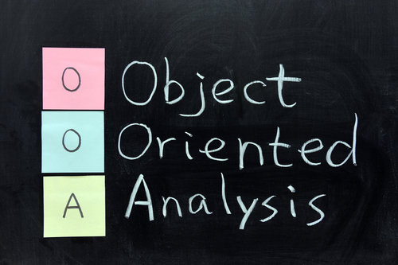
Review of OOAD
◆
Object oriented analysis and design is a software engineering approach which models the system as interacting objects.
◆
Each object represents a system entity which plays a vital role in building of that system.
Object Oriented Analysis (OOA) focuses on analysis of functional requirements for the system.
◆
◆
Object Oriented Design (OOD) takes analysis model as input and produces implementation specification.
Object Oriented Analysis Model
Object Oriented Design Model
Implementation Specification
Functional Requirements
UML 4

Slide 4
Modeling
Object orientation and Class Modeling
Introduction to Object orientation and Modeling, Three Models, Object and class concepts, link and association
Generalization and Inheritance, Advanced Object and class concepts, Association Ends, N- ary associations
Aggregation, abstract classes, multiple inheritance, Metadata, Constraints, Derived data, Packages
State modeling and Interaction Modeling
Events, states, Transition and conditions, state diagram, state diagram behavior
Use case Models
Sequence models, activity models

Slide 5

Modeling
◆ There are three important type of UML models:
1.Class Model 2.State Model 3.Interaction Model

Slide 6
Modeling
1) Class model
The class model describes the structure of the object, the relationship of one object with other objects, attributes and operations of the object.
The goal of the class model is to capture the concepts from the real worlds that are useful for your application
The class model is represented by the class diagrams. The classes in this diagrams define the attributes and operations of each object.

Slide 7
Modeling
2) State model
The state model is concerned operations of the object.
with the time and sequencing of the
On occurrence of the events the object change their state.
The state Model captures the control aspect of the system.
The state model is represented by State diagram. Each state diagram represents state and the event sequences.

Slide 8
Modeling
3) Interaction Model
Interaction model describes how one object collaborates with other in order to achieve behaviour of the system
The overall behaviour of the system can be represented with the help of state and interaction model.
The interaction model includes use case diagrams, sequence diagrams and Activity diagrams.
The use case diagrams show how to outsider actor interacts with the system to achieve functionality.
The sequence Diagram represents the objects that interact and the time sequence of their interaction
The activity Diagram represents flow of control among objects.

Slide 9
CLASS MODELING

Slide 10
Introduction to class modeling
A class model captures the static structure of a system by characterizing the objects in the system, the relationships between the objects and the attributes and operations for each class of objects.
◆
Class model provides a graphical representation of a system and are used for communicating with customers.
◆

Slide 11
Class and Object Concept
Classes
Class is a group of objects having same attributes and operations, relationships and semantics.
The classes appear as common nouns or noun phrases.
Objects in a class share a common semantic purpose. For Example both the dog and cat have the properties like tail and legs and they belong to same class Animal.
Grouping the objects into corresponding classes make the design Abstract.
Objects
The main purpose of class model is to describe objects.
Object is an instance of a class.
The objects can be conceptual entities, real world entities, or important things from implementation point of view.
The choice of objects is done by judgements.
For Example: If a student is a class then x,y,zare the obUMjeL 1c1ts of the class students. Each student has its own name, roll no, and address.

Slide 12
Class Diagrams
◆
The class Model is represented by two types of diagrams:-
1) Class Diagrams
Class diagrams provide a graphic notation for modeling classes and their relationships thereby describing possible objects.
◆
◆
Useful for abstract modeling and designing actual programs.
◆
They are concise ,easy to understand
2) Object Diagrams
◆
Object diagrams shows individual objects and their relationship .
◆
A class diagram corresponds to an infinite set of object diagrams.

Slide 13
Continue….
#Notation used for class & object diagram:
→ For class diagram:-
Person
→For object diagram:-
Smith:Person
Mary:Person

Slide 14
Values and Attributes
◆
A value is a piece of data.
An attribute is a named property of a class that describes a value held by each object of the class.
◆
◆
E.g. Name,birthdate and weight are attributes of Person class.
- Color,modelyear and weight are att. Of Car class.
◆
Each attribute name is unique within a class.
◆
So Person and Car class have attribute called weight.

Slide 15
Values and Attributes continue….
# Example:-
→List att. In the second compartment of the
class box.
Person
name: string b’date:date
Class Name
Attributes
Smith:Person
Mary:Person
name: "Joe Smith” b’date:21/10/1983
name: “Mary Sharp” b’date:16/03/1953

Slide 16
Operations and Methods
◆
Objects have procedures or functions which are called as operations.
◆
All the objects in the same class share the common set of operations.
For Example- The class Shape can have various objects such as rectangle, triangle or square having common operations such as move, draw, print.
◆
◆
A method is the implementation of an operation for a class.
When an operation has methods on several classes it is important that the methods all have the same Signature.
◆
◆
Signature means the number and types of arguments and type of return value.
◆
e.g. print should not have fileName as an argument for one method filePointer
for another.
UML 16

Slide 17
Operations and Methods continue…
→Feature is a generic word for either an attribute or operation.
→UML notation is to list operations in the third compartment of the class box.
#Examples:-
Person
name: string b’date:date
changeJob changeAddress
File
fileName sizeInBytes lastUpdate
print
GeometricObject
color position
move(delta : Vector) select(p:Point):Boolean rotate(in angle:float=0.0

Slide 18
Summary of Notation for classes
→The attribute and operation compartments are optional.
→A missing attribute / operation compartment means that attributes / operations are unspecified.
→An empty compartment means attributes/operations are specified and that are none.
ClassName
attName1:dataType1=defaultValue1 attName1:dataType1=defaultValue1
. . .
operationName1(argList1) : resultType1 operationName2(argList2) : resultType2
. . .

Slide 19
Link and Association
◆
A link is a physical or conceptual connection among objects.
◆
Most link relate two objects but some links relate three or more objects.
◆
e.g. Smith works for simplex company.
◆
A link is an instant of an association.
◆
An Association is a description of a group of links with common structure and common
semantics.
◆

Slide 20
Link and Association continue…
◆
An association connects related classes and it is also denoted by a line. (with
multiple line segments)
◆
It is good to arrange the classes in an association from left to right ,if
possible.
◆
The associations and links often appears as verbs in problem statements.

Slide 21
Link and Association continue…
Person | OwnsStock | Company
 | * *
name |  | name
Class diagram
→ For example,
a person
John:Person
name=“john”
GE:Company
Mary:Person
name=“Mary”
Name=“GE”
Sue:Person
IBM:Company
Name=“IBM”
Object diagram
Name=“Sue”
Jeff:Person
Name=“jeff”

Slide 22
Multiplicity
◆
Multiplicity specifies the number of instances of one class that may relate
to a single instance of an associated class.
◆
UML diagrams explicitly list multiplicity at the end of the association lines.
◆
Multiplicity Indicators
Exactly one | 1
Zero or more (unlimited) | * (0..*)
One or more | 1..*
Zero or one (both inclusive) | 0..1
Specified range | 2..4
Multiple, disjoint ranges | 2, 4..6, 8

Slide 23
Multiplicity Continue…
 | HasCapital | CapitalCity
Country
 | 1 1
 |  | name
name
Class diagram
 | HasCapital | Ottawa:CapitalCity
Canada:Country
 |  | Name=“Ottawa”
Name=“Canada”
HasCapital
Paris:CapitalCity
France:Country
Name=“France”
Name=“Paris”
Object diagram

Slide 24
Workstation
1
0…1
Window
console
Zero-or-one multiplicity

Slide 25
Multiplicity vs. cardinality
Multiplicity is a constraint on the size of a collection
Cardinality is the count of elements that are actually in the collection.
Multiplicity is a constraint on cardinality.

Slide 26
Association vs. Link
A
anAssociation
B
*
*
Class Diagram
anA:A
aLink
aB:B
*
*
Object Diagram
A pair of objects can be instantiated at most once per association

Slide 27
Association vs. Link
A
anAssociation
B
*
*
*
*
anotherAssociation
Class Diagram
anA:A
aLink
aB:B
*
*
*
*
anotherLink
Object Diagram
Multiple associations are used to model multiple links between the same objects

Slide 28
Association End Names
◆
If we consider one to many association then it has two ends-an end
with a multiplicity of “one” and an end with a multiplicity of “many”.
◆
We can also give the name to both the ends.
◆
Association end names often appear as nouns in problem descriptions.
◆
Example
Person
employee
WorksFor
employer
Company
*
0..1

Slide 29
Association End Names Continue…
◆
Association end names are necessary for associations between two
objects of the same class.
◆
For example container and contents distinguish the two usage of
Directory class.
owner 1
*
0..1 container
User
Directory
authorizedUser
*
*
* contents
Each Directory has exactly one user who is an owner and many users who are authorized to use the directory.

Slide 30
Association End Names Continue…
◆
Association end names let you unify multiple references to the same
class.
◆
When constructing class diagram you have to use proper association
end names not introduce separate class for each reference as shown in below fig.
Parent |  | Child
 | 2 *
Person
parent
0..2
child
*
Wrong model
Correct model
Association end names should be unique

Slide 31
Ordering
◆
Often the objects on a “many” association end have no explicit order and we
regard them as a set. Sometimes the objects have an explicit order.
{ordered}
1
 |  | WebPages
Browser
 | Displays *
◆
The Web Browser displays the web pages in some specific order (FCFS).Hence
{ordered} keyword is used at the association end.

Slide 32
Bags and Sequences
A bag is a collection of elements with duplicates allowed .
A sequence is an ordered collection of elements with duplicates allowed.

Slide 33
Association Classes
◆
The abstract class is a class that allows the association to be a class itself.
When two classes are related with each other by an association link, then the association itself can have attributes and operations
◆
◆
Hence, association can be represented by a class.
The UML notation for an association class is a box attached to the association by a dashed line.
/etc/abc.txt read John
◆
File | * * | User
AccessibleBy
accessPermission
UML 28

Slide 34
Qualified Associations
◆
A qualified association is an association in which an attribute called the
Qualifier, disambiguates the objects for a “many” association end.
◆
possible to define for one-to-many and many-to-many asso.
A qualifier selects among the target objects, reducing multiplicity from “many” to “one”.
◆
◆
Example:- A bank services multiple accounts.

Slide 35
Qualified Associations Continue…
Bank
a/cNo.
1
Qualifier
0..1
Bank
 | 1 *
Account
a/cNo.
Account
Qualified
Not qualified

Slide 36
Generalization and Inheritance
◆
Generalization is the relationship between a class (super class)
and one or more variations of the class (subclasses).
Super Class
Super Class (Base class)
◆
Provides common functionality and data members
Subclass (Derived class)
…
◆
Inherits public and protected members from the super class
◆
Can extend or change behavior of super class by overriding
methods
Subclass
Overriding
UML 31
◆
Subclass may override the behavior of its super class

Slide 37
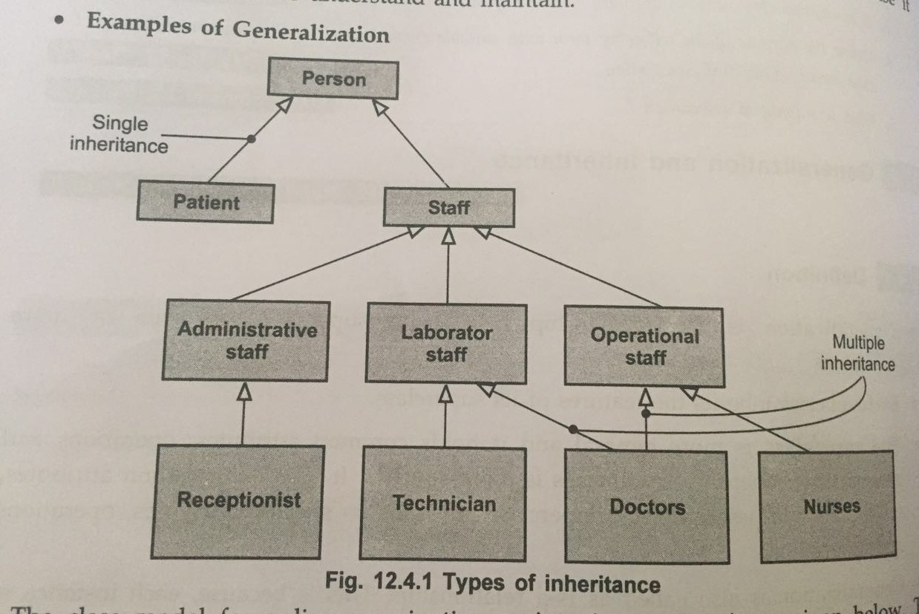
Generalization and Inheritance Continue…
→A large hollow arrowhead denotes generalization.

Slide 38
Generalization – advantages
◆ Polymorphism
◆ Find common characteristics among classes
◆ Define hierarchies
◆ Reuse of the code

Slide 39
Drill
1. A model is a _________ of reality.
a. Complication
b. Simplification
c. Realization
d. Generalization
2. A link is an instance of ________
a. Generalization
b. Association
c. Dependency
d. Realization
3. Object diagram is used to show the design ________ view of a system.
a. static
b. dynamic
c. logical
d. process

Slide 40
4. An object is considered an external entity in object-oriented modeling
Select one:
a. it has numerous attributes
b. its attributes are invariant during operation of the system
c. its attributes change during operation of the system
d. it has no attributes relevant to the system
.5. ……………… concerned with developing an object-oriented model of a software system to implement the identified requirements. A) Object oriented analysis B) Object oriented methods C) Object oriented design D) Object oriented programming

Slide 41
Drill
1. A model is a _________ of reality.
a. Complication
b. Simplification
c. Realization
d. Generalization
2. A link is an instance of ________
a. Generalization
b. Association
c. Dependency
d. Realization
3. Object diagram is used to show the design ________ view of a system.
a. static
b. dynamic
c. logical
d. process

Slide 42
4. An object is considered an external entity in object-oriented modeling
Select one:
a. it has numerous attributes
b. its attributes are invariant during operation of the system
c. its attributes change during operation of the system
d. it has no attributes relevant to the system
.5. ……………… concerned with developing an object-oriented model of a software system to implement the identified requirements. A) Object oriented analysis B) Object oriented methods C) Object oriented design D) Object oriented programming

